Slide 1

Weather Data Analysis System
Final Review
Team Members:
G.Raj Kumar (25B11CS282)
K.Raghuveer (25B11CS426)
M.Sirisha (25B11CS546)
T.Heleena Grace (25B11CS925)
Notes:
1

Slide 2
CONTENTS
• Introduction
• Problem Definition
• Proposed Solution
• Proposed Workflow
• Data Used
• Modules
• Implementation (Python Code Demonstration)
• Results and Key Findings
• DAE Concepts and Programming Concepts
• Applications

Slide 3
Introduction
• About: Weather Data Analysis System that studies synthetic weather
data of five cities using Python.
• Domain: Data Analytics Essentials.
• Code & output: every module is shown with its code and the output
it produced.
• Results: trend statistics, Celsius to Fahrenheit conversion and four
charts.
• Concepts & progress: DAE concepts, programming concepts,
contributions and status.

Slide 4
Problem Definition
• Existing problem: raw weather data is large and unorganized, so changes are hard to see from numbers alone.
• Difficulties: manual analysis is slow and can miss patterns such as high and low temperatures.
• Who is affected: anyone who relies on weather information, such as agriculture, travel and education.
• Needs improvement: a clear method to clean, analyze and visualize historical weather data.

Slide 5
Proposed Solution
• Major functions: read data, clean it, analyze temperature trends, convert units, visualize results.
• Input → Processing → Output: CSV file → Pandas and NumPy processing → statistics, Fahrenheit values and charts.
• Expected users: students and anyone studying historical weather.
• Expected benefits: patterns become easy to see in tables and charts.

Slide 6
Proposed Workflow
1
Read
Load the CSV file with Pandas
2
Clean
Missing values, data types, duplicates
3
Analyze
Monthly, yearly and city temperature trends
4
Convert
Celsius to Fahrenheit and back
5
Visualize
Line chart, histogram, bar and pie charts

Slide 7
Data Used
Item | Details
Source | Synthetic weather dataset in CSV format , created for academic practice
Type | Structured data: numerical measurements with city, date and weather condition
Records | 2,500 records (2021–2025) for Bengaluru, Chennai, Delhi, Hyderabad and Mumbai
Columns | Date, City, Temperature_C, Humidity_pct, Rainfall_mm, Wind_Speed_kmh, Pressure_hPa, Visibility_km, UV_Index, Weather_Condition
Format | CSV file, loaded into a Pandas DataFrame

Slide 8
Modules
Module | What it does
Reading data | Loads the CSV (2,500 rows × 10 columns) with pd.read_csv
Cleaning & preprocessing | Fills 11 missing values, converts Date, checks duplicates
Temperature trend analysis | Monthly, yearly and city-wise average temperature
Unit conversion | Celsius ↔ Fahrenheit functions with a round-trip check
Visualization | Line chart, histogram, bar chart and pie chart

Slide 9
Implementation (Python Code Demonstration)
Reading data → Cleaning → Trend analysis → Unit conversion → Visualization
Executed in Google Colab using Pandas, NumPy and Matplotlib

Slide 10
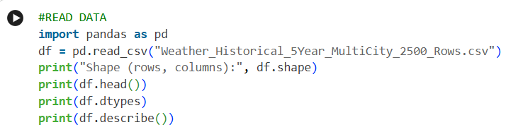
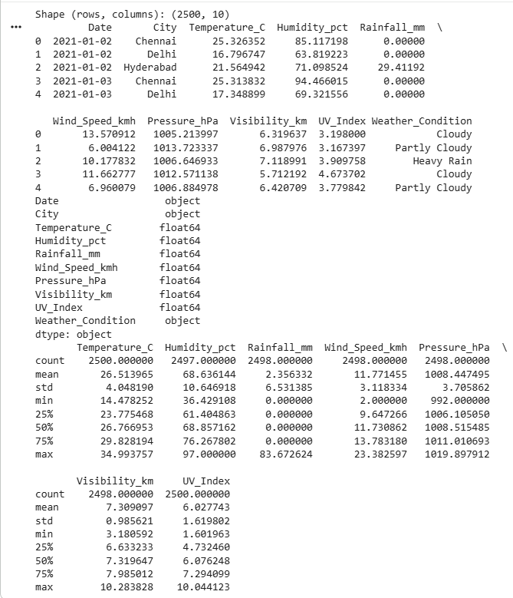
Reading Data: Code & Output
What it shows
• Dataset loaded with pd.read_csv() into a DataFrame (df).
• Shape is (2500, 10): 2,500 records and 10 columns.
• Columns: Date, City, Temperature_C, Humidity_pct, Rainfall_mm, Wind_Speed_kmh, Pressure_hPa, Visibility_km, UV_Index, Weather_Condition.
• describe() counts show Humidity 2497 and Rainfall 2498, so some values are missing.

Slide 11
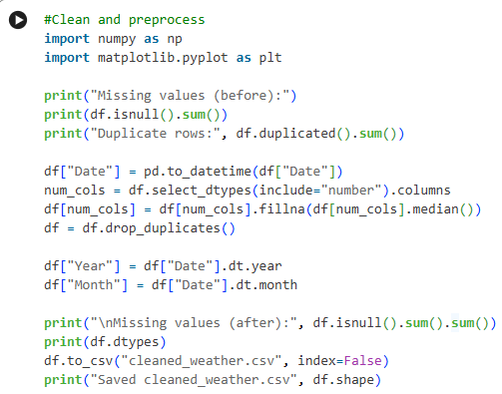
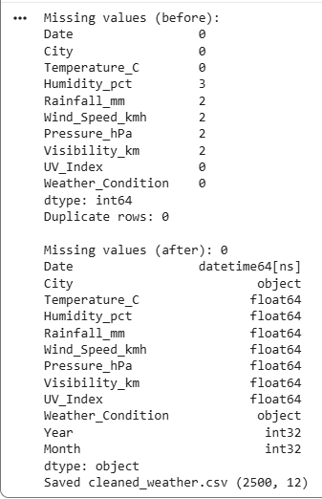
Cleaning & Preprocessing: Code & Output
What it shows
• isnull().sum() found 11 missing values: Humidity 3, Rainfall 2, Wind Speed 2, Pressure 2, Visibility 2.
• Duplicate rows: 0.
• Date converted to datetime; missing values filled with the column median; Year and Month columns added.
• After cleaning: 0 missing values. Saved as cleaned_weather.csv (2500, 12).

Slide 12
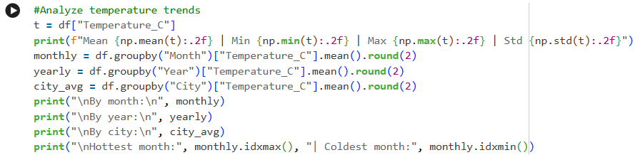
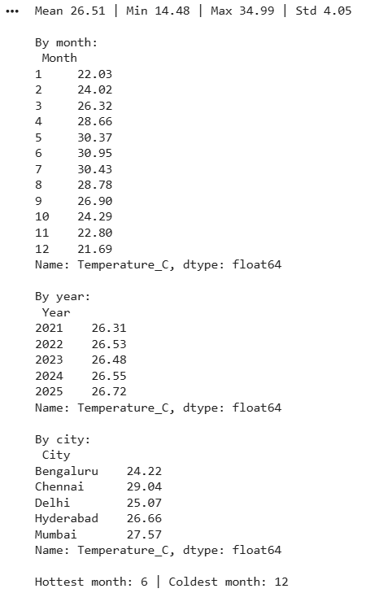
Temperature Trend Analysis: Code & Output
What it shows
• Mean 26.51 °C, minimum 14.48 °C, maximum 34.99 °C, standard deviation 4.05.
• Hottest month: June (30.95 °C). Coldest month: December (21.69 °C).
• Yearly average rises slightly from 26.31 °C (2021) to 26.72 °C (2025).
• Chennai is the warmest city (29.04 °C) and Bengaluru the coolest (24.22 °C).

Slide 13
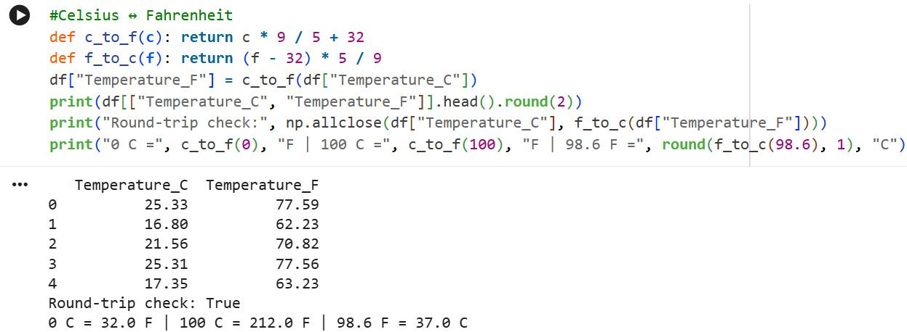
Celsius ↔ Fahrenheit Conversion
• Functions c_to_f() and f_to_c() use F = C × 9/5 + 32 and C = (F − 32) × 5/9.
• A Temperature_F column was added: the first record, 25.33 °C, is 77.59 °F.
• Round-trip check is True. Test values: 0 °C = 32 °F, 100 °C = 212 °F, 98.6 °F = 37.0 °C.

Slide 14
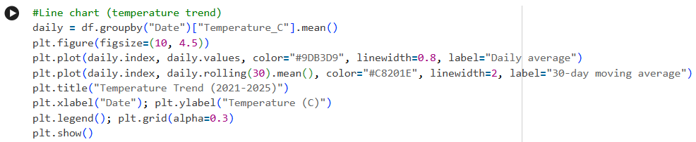
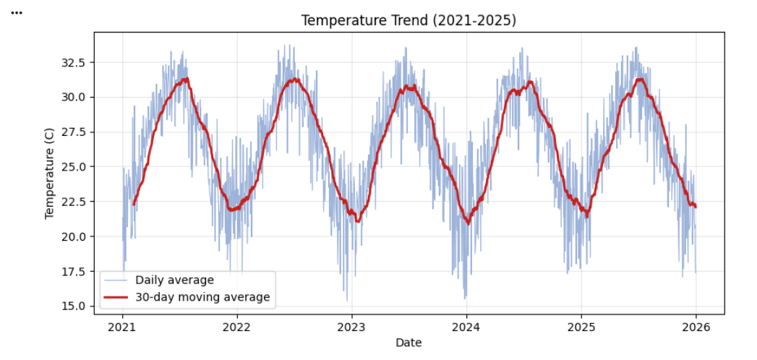
Line Chart: Temperature Trend
What it shows
• Light blue line: average temperature of each day. Red line: 30-day moving average.
• A clear yearly cycle repeats from 2021 to 2025: highest around mid-year, lowest around year-end.
• The moving average smooths daily noise and shows the trend.

Slide 15
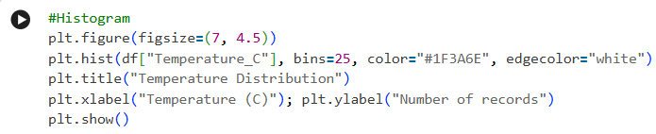
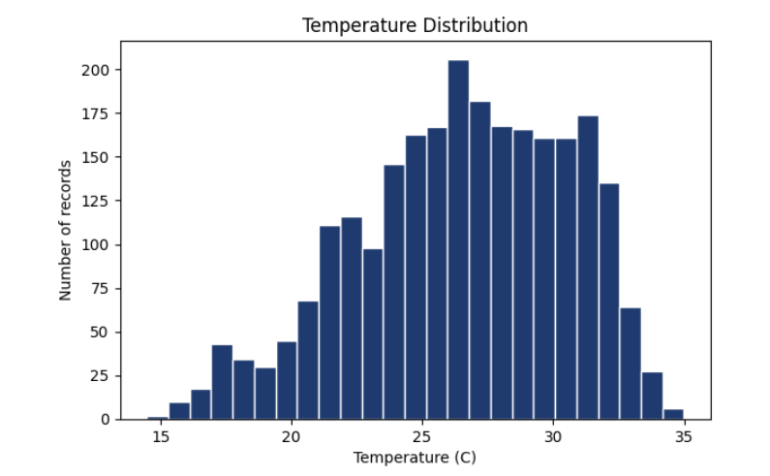
Histogram: Temperature Distribution
What it shows
• 25 bins of Temperature_C; values range from about 14.5 °C to 35 °C.
• Middle 50% of records lie between 23.78 °C and 29.83 °C.
• The tallest bar is near 26–27 °C (about 200 records); the left tail is longer, so cooler days are less common but spread out.

Slide 16
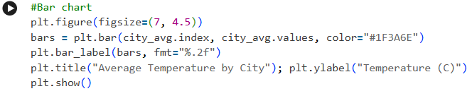
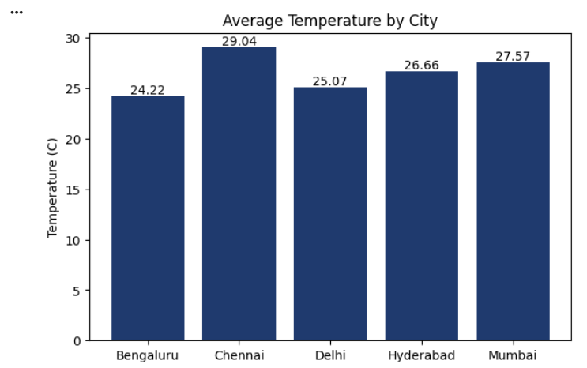
Bar Chart: Average Temperature by City
What it shows
• Chennai 29.04 °C, Mumbai 27.57 °C, Hyderabad 26.66 °C, Delhi 25.07 °C, Bengaluru 24.22 °C.
• Chennai is about 4.8 °C warmer than Bengaluru on average.

Slide 17
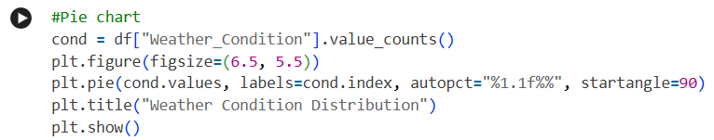
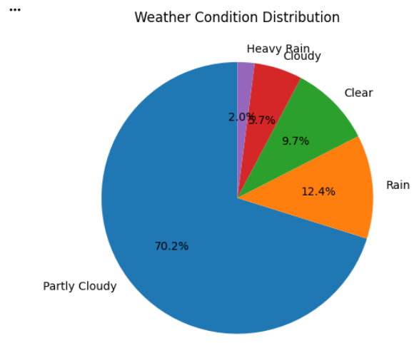
Pie Chart: Weather Condition Distribution
What it shows
• Partly Cloudy 70.2%, Rain 12.4%, Clear 9.7%, Cloudy 5.7%, Heavy Rain 2.0%.
• Partly Cloudy is by far the most common condition; Heavy Rain is rare.

Slide 18
Analysis Results: Key Findings
• Temperature range: 14.48 °C to 34.99 °C, mean 26.51 °C.
• Seasonal pattern: June is hottest (30.95 °C), December coldest (21.69 °C), a gap of about 9.3 °C.
• Cities: Chennai is warmest (29.04 °C) and Bengaluru coolest (24.22 °C).
• Yearly trend: average rises slightly from 26.31 °C in 2021 to 26.72 °C in 2025.
• Conditions: Partly Cloudy 70.2% of records; Heavy Rain only 2.0%.

Slide 19
DAE Concepts Used
DAE Concept | How it is used in our project
Data Collection | weather dataset in CSV format (2,500 records)
Data Preprocessing | Missing values filled with median, Date converted, duplicates checked
Descriptive Statistics | Mean, minimum, maximum and standard deviation of temperature
Grouping & Aggregation | groupby on Month, Year and City
Data Transformation | New columns: Year, Month and Temperature_F
Data Visualization | Line chart, histogram, bar chart and pie chart
Insight Generation | Seasonal pattern, city differences and yearly trend

Slide 20
Programming Concepts Used
• Pandas: read_csv, isnull, fillna, drop_duplicates, groupby, to_datetime and to_csv.
• NumPy: np.mean, np.min, np.max, np.std for statistics and np.allclose for the round-trip check.
• Matplotlib: plot, hist, bar and pie charts with titles, labels and legends.
• Functions: c_to_f() and f_to_c() are reusable conversion functions.
• Rolling window: .rolling(30).mean() gives the 30-day moving average.
• Date handling: .dt.year and .dt.month extract Year and Month from Date.

Slide 21
Applications of Weather Analysis
Area | How weather analysis helps
Climate Research | Scientists study long-term temperature trends and how they change over the years
Agriculture | Farmers review which months are usually hot or cool in their area when choosing crops
Tourism | Travel companies compare the climate of different cities to find the best season to visit
Weather Departments | Past records are summarized into averages, extremes and yearly reports
Education | Students learn data analysis using real data, as in this project
City & Infrastructure Planning | Authorities review past heat and rainfall records to understand local conditions

Slide 22
Conclusion
The results show clear seasonal patterns, differences between cities, and a slight yearly rise in temperature.
This project helped us understand how raw data can be transformed into meaningful information.
We also learned how to use data analysis to understand weather patterns more clearly.

Slide 23

THANK YOU

